Slide 1
Object Orientated Programming

Slide 2
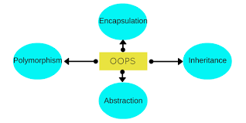
Oops Paradigm
Object orientated Programming basically stands on four pillers

Slide 3
Abstraction:
Hiding internal details and showing functionality is known as abstraction. Data abstraction is the process of exposing to the outside world only the information that is absolutely necessary
Encapsulation:
Binding (or wrapping) code and data together into a single unit is known as encapsulation.
Inheritance:
When one object acquires all the properties and behaviours of parent object i.e. known as inheritance.
Polymorphism:
When one task is performed by different ways i.e. known as polymorphism.

Slide 4
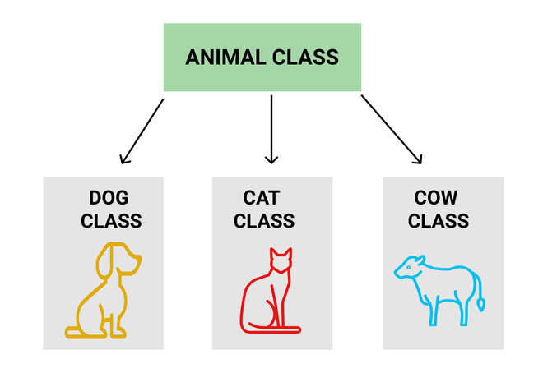
Class and Objects
Class:
a class is a template definition of the methods and variables in a particular kind of object. Collection of objects is called class.

Slide 5
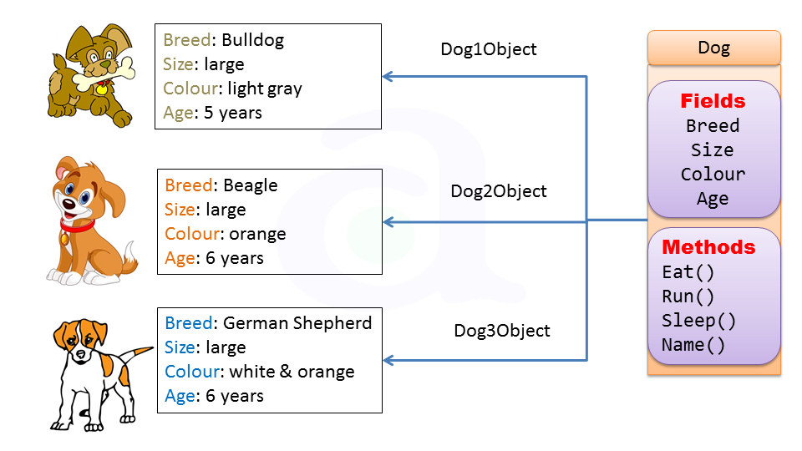
Object:
Any entity that has state and behavior is known as an object. For example: chair, pen, table, keyboard, bike etc. It can be physical and logical.

Slide 6
Access Specifiers
Private:
members are accessible from outside the class.
Public:
members cannot be accessed (or viewed) from outside the class
Protected:
members cannot be accessed from outside the class, however, they can be accessed in inherited classes.

